Slide 1
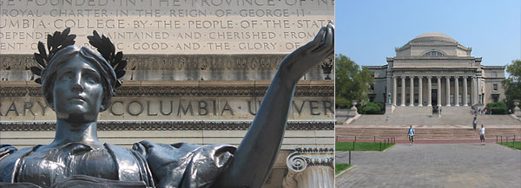
Columbia University Office of the General Counsel
Patenting Biotech:
Strategies and Tips for Protecting Your Invention
Gonzalo Merino, Ph.D., J.D.
Associate General Counsel
Patent and Licensing Group

Slide 2
What does the Patent and Licensing Group do?
Columbia Innovators
~300 inventions/year
Patent and Licensing Group
(“PLG”)
Columbia Technology Ventures
(“Tech Ventures”)
Outside Legal Counsel
►~220 new patent applications
►~50 licenses and options
►~50 industry-sponsored research agreements
►~15 start-ups
►~135M in gross IP revenue

Slide 3
Overview:
What is a patent?
How do I get a patent?
What can I do to give my biotech invention the best chance of being patented and becoming a commercial product or service?

Slide 4
What is a patent?
Exclusive right in exchange for disclosing an invention
U.S. Constitution
The Congress shall have the power ... [t]o promote the
Progress of Science and useful Arts, by securing for limited
Times to Authors and Inventors the exclusive Right to their
respective Writings and Discoveries.
Available in most countries
Limited temporally and geographically

Slide 5
What are the requirements for a patent?
Patentable subject matter
Useful
Novel
“new”- same thing did not exist
Non-obvious
a person having ordinary skill in the art
would not come up with the invention
based on what is already known
Written description, enablement, and best mode
Prior Art

Slide 6
How do you apply for a patent at Columbia?
Identify an invention
consider criteria for patentability
consult with Tech Ventures
Submit Invention Report (IR) to Tech Ventures
Review invention with Tech Ventures and PLG
evaluate patentability and marketability
Work with attorneys to prepare application
email techventures@columbia.edu
www.techventures.columbia.edu

Slide 7
How do you apply for a patent at Columbia?
PLG
Analyze Patentability
Prepare and File Patent
Prosecute Patent
Docket Review
File Invention Report
Discovery
Commercial Analysis
License Negotiation
Post-contract compliance
Tech Ventures
Marketing

Slide 8
What are the timeline and cost of obtaining a patent?
0 months
12
30/31
4-6 years
Prosecution
Provisional
“Full”
International
National stage
Patent issues
$50k
~$100-150k
per application
per country
$25k

Slide 9
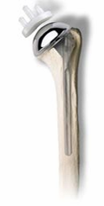
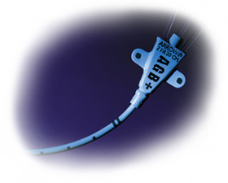
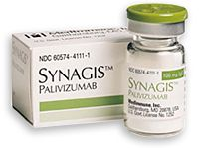
Products Using Columbia Technology
DISCOVERY STUDIO
Arrow Catheter
Notes:
9

Slide 10
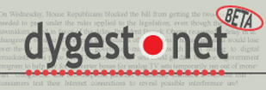
Over 115 Startups in 17 Years 74+ still active, 33 VC-backed, 12 gone public, 13 acquired
System Management ARTS (SMARTS)
Notes:
10

Slide 11
Where Does the Money Go? University Policy on Distribution of License Revenues
Gross Revenue
First $125K
Gross Revenues
Over $125K
Note: Certain caps and deductions may apply. Please refer to Appendix D of the Faculty Handbook for details.
Notes:
11

Slide 12
What can I do to give my biotech invention the best chance of getting patented and becoming a commercial product or service?

Slide 13
Contact Tech Ventures and submit an Invention Report (IR) as soon as possible.
email techventures@columbia.edu

Slide 14
Protect against disclosures and activities:
Disclosures
Manuscripts, abstracts, slides or posters
in print or online
distributed before a meeting
Indexed theses/dissertations
Funded grants*
Sequence databases
Class handouts
Activities
Oral presentations or discussions
Practicing invention for commercial gain
US Grace Period

Slide 15
Submit IR and contact Tech Ventures before:
Such disclosures and activities
file patent application
Discussing invention with a company or collaborator
obtain a Confidential Disclosure Agreement (CDA) or Collaboration Agreement
Document the invention
Avoid disputes

Slide 16
Alert us to IP Provisions in agreements:
Material Transfer (MTAs)
Private Grants
Consulting
Employment
Work-for-Hire
Sponsored Research
Collaboration
Visiting Scientist
Equipment Leases

Slide 17
Preserve evidence of conception: keep an organized lab notebook.
Make entries on same day as event
Sign and date each page
A witness who understands the work but is not an inventor or collaborator should sign and date each page
Bound notebook
Use pen
Write legibly
Cross out errors, do not erase
Consecutive entries – no empty spaces
Keep in safe location

Slide 18
Report your invention on the IR as thoroughly as possible.
Attach data, slides, manuscripts, grants, agreements…
Answer all questions and sign the IR
Evidence of conception
Thorough patent and market analysis

Slide 19
Make us aware of any potential inventors as soon as possible.
Avoid disputes
Conception is key
Inventorship ≠ authorship
Outside legal counsel
independent good faith analysis

Slide 20
Focus on developing invention during the first 12 months after filing.
0 months
12
30/31
4-6 years
Prosecution
Provisional
“Full”
International
National stage
Patent issues
Critical time period for data
support patentability
justify continued expense

Slide 21
Challenges of obtaining the necessary information:
Very quick 12 months
Identifying the information
Tech Ventures and PLG
Potential licensees
May not be scientifically interesting
Collaboration
Money
Sponsored Research Agreements
Collaboration
Alternative funding sources

Slide 22
Take home message: “Timing is everything” (1) Contact Tech Ventures and submit an Invention Report (IR) as soon as possible. (2) Focus on developing invention during the first 12 months after filing.
email techventures@columbia.edu

Slide 23
To receive a copy of this presentation or if you have any questions or comments, please contact: Gonzalo Merino at gm@gc.columbia.edu Thank You

