Slide 1
Entrepreneurship in Biotechnology
Columbia University
Graduate School of Arts and Sciences
BIOT 4180

Slide 3
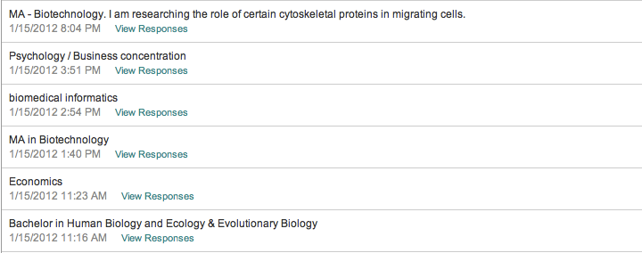
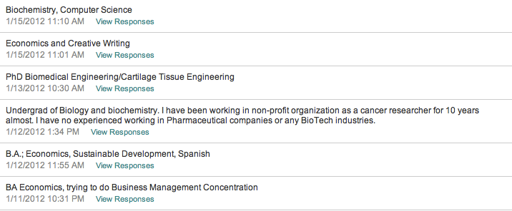

Slide 5
Week 1

Slide 6
World Economy

Slide 7
Healthcare Spending
World GDP 74,540 B
CIA 2010
World healthcare economy 7,500 B
extrapolated
World biotechnology revenue 84.6B
Ernst & Young 2010
US GDP 14,660B
CIA 2010
US healthcare economy 2,600 B
CMS 2010
US biotechnology revenue 61.6 B
Ernst & Young 2010

Slide 8
Comparative revenues
Walmart revenue* 419 B
New York State government spending 133 B
New York State Division of the Budget
Pfizer revenue* 67 B
Apple computer revenue* 65 B
Pharma and biotech R&D 65 B
(PhRMA, Burrill 2009)
US biotech industry 62 B
Coca Cola revenue* 32 B
NIH grants 31 B
Starbucks revenue* 11 B
Columbia University budget 2.7 B
Columbia office of Management and Budget
*Capital IQ

Slide 11
Segments
Therapeutics ←
Devices
Diagnostics
Agricultural
Manufacturing
Industrial

Slide 12
Why study the biotech industry?
All entrepreneurship is hard
Biotech is harder
High regulatory hurdle
Technical difficulty
Long need for funding
Major shifts in needed competence
Discovery, Development (stages)
Development, Regulatory
Funding, Commercialization, Strategic development

Slide 13
…and getting harder

Slide 15
Concurrent Processes
Development cycle
Platform
Define proof of concept
Pipeline and lead progress
Funding cycle
Identifying value inflections
Seed through secondary public or partnerships
Funding environment may or may not reward value inflections

Slide 16
Scientific Development

Slide 17
Funding Cycle
Seed
Angel
Venture
Public
Secondary
Partnership or sale

Slide 18
Matching Funding to Value Inflection

Slide 19
Biotech Companies in Lean Times

Slide 20
Imprecise schedule
Week 2: business communication and business structures
Week 3: business plan 1
Week 4: accounting and finance
Week 5: early stage funding
Week 6: late stage funding
Week 7: patents and IP protection
Week 8: management
Week 9: microeconomics
Week 10: clinical development
Week 11: partnering, m&a and exits
Week 12: evaluating a company as a potential employee
Week 13: future of biotechnology
Week 14: review
-entrepreneurship
-business as a second language
-biotechnology

Slide 21
Course structure
14 weekly meetings from 4-6 PM
Weekly assignments that form the basis for the next session
Students will be called upon frequently to present their work (this classroom is our lab)
A final exam

Slide 22
Student evaluation
35% assignments
35% class participation
30% final exam

Slide 23
Class participation is integral and absences will markedly decrease the value of the course
Communicate with me through email: dbs2154@columbia.edu
Speakers
Survey results

Slide 24
Evolution of a business
Idea
Organization and identity and pitch
Seed capital
Define what is proprietary and initiate a strategy to protect it
Establish proof of concept

Slide 25
Three Statements
3-5 word description
Elevator pitch
Business Plan
Accounting

Slide 26
Assignment
Be prepared to present a 30-60 second elevator pitch at the start of the next class

