Slide 1
Week 4
Accounting

Slide 2
In the beginning…
The ledger: a written record of every transaction
  Use of funds to purchase an asset
  Sale of asset for cash
Double entry: an enforced balance between inflows and outflows for the company
First entry: owner(s) writes a check and the company issues equity

Slide 3
Business Basics
Accounting
  Double entry bookkeeping
    Debit: increase in asset or decrease in liability
    Credit: decrease asset or increase liability or equity
  Financial statements
  Amortization and depreciation
  Expenses and expensing
  Tax considerations

Slide 4
Financial Statements
From the ledger, 3 statements follow
  Balance sheet
  Income statement
  Statement of cash flows
Balance sheet exists from inception
Income and cash flow are different

Slide 5
Balance sheet
“Snapshot in time” of the financial condition of the company
What the company owns, what it owes and who lays claim to what’s left
Assets on one side, liabilities and owners’ equity on the other
Income statement is between two balance sheets
Depreciation of assets, amortization of goodwill
Tracy

Slide 6
Balance Sheet
General form
  More liquid assets at the top
  Current assets and current liabilities (used within 1 yr)

Slide 7
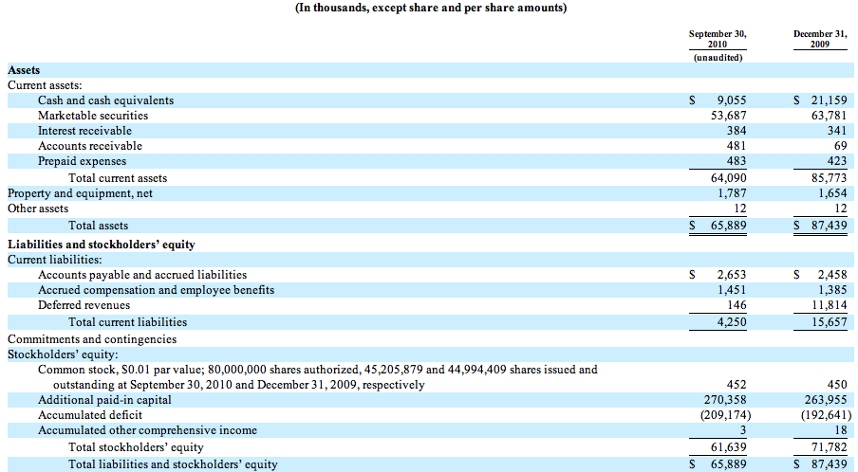
Balance sheet

Slide 8
Assets
Buildings and equipment are depreciable
Land is not
Depreciation can be accelerated
Inventories: can be counted in different ways
  FIFO
  LIFO
General principal is that companies with profits want to maximize recognition of expenses early to decrease taxes
Opposite can be true (max profits to make stock go up)
Need for consistency

Slide 9
Capital Structure
The combination of debt and equity on which the company is built
  Debt: borrowed funds with a fixed interest rate and date of repayment. Debt holders have first liquidation preference
  Equity: ownership of assets after debt holders have been repaid
  Hybrids: preferred stock, convertible debt

Slide 10
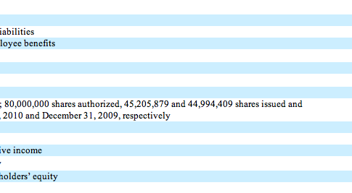
Simple Cap Structure

Slide 11
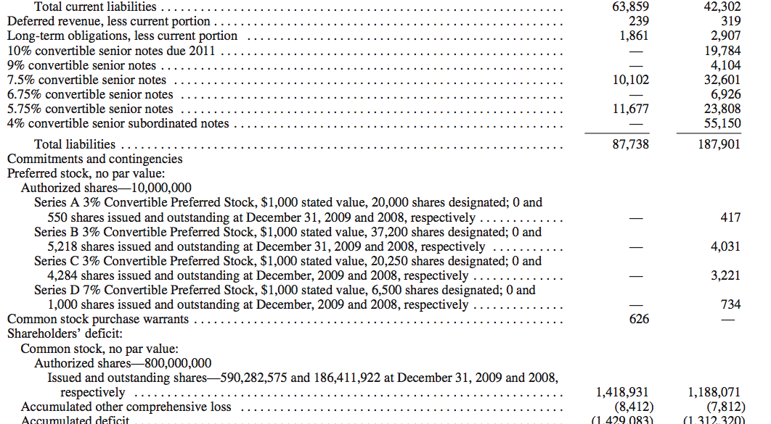
Complex cap structure

Slide 12
Other statements bridge two balance sheets
Bridges two balance sheets
Balance sheet assumptions affect the income statement
  Eg inventory valuation -> cost of goods sold

Slide 13
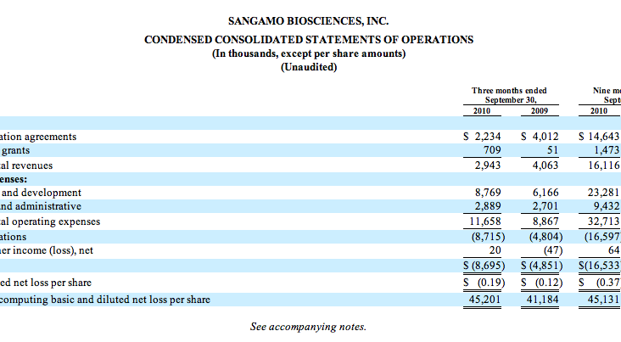
Income statement

Slide 14
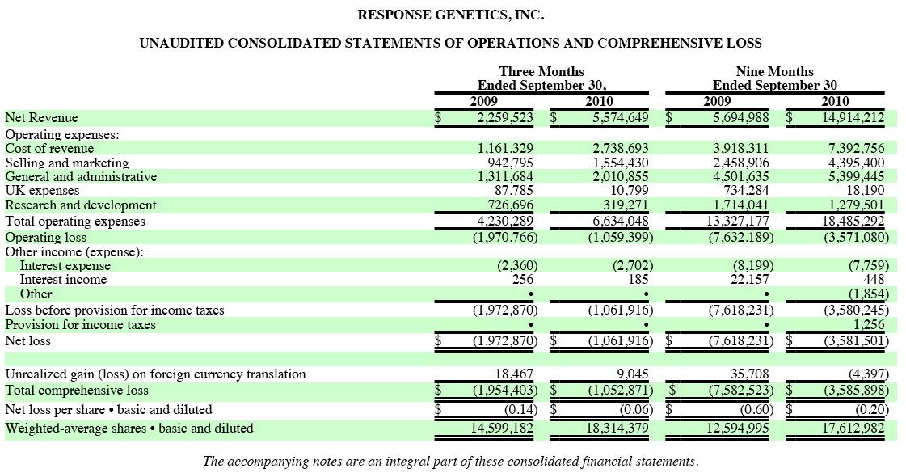
Income Statement with product sales

Slide 15
Cash Flow Statement reconciles changes in cash bet balance sheets
Operating income for income statement
  Add back non cash items (dep, amort, prepays, deferrals)
  Add / subtract financing and investing in/outflow

Slide 16
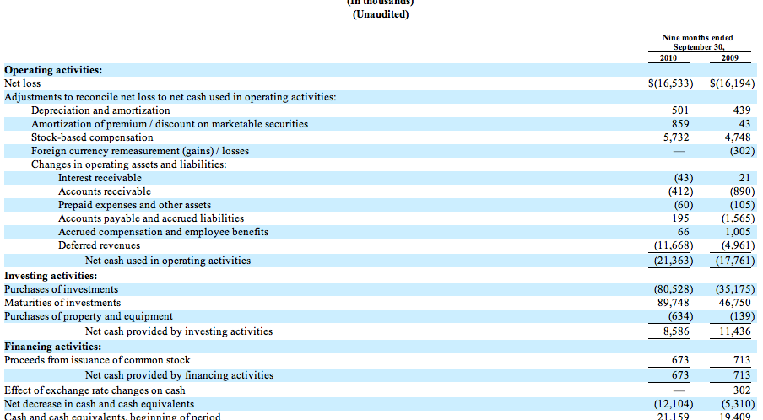
Cash Flow Statement

Slide 17
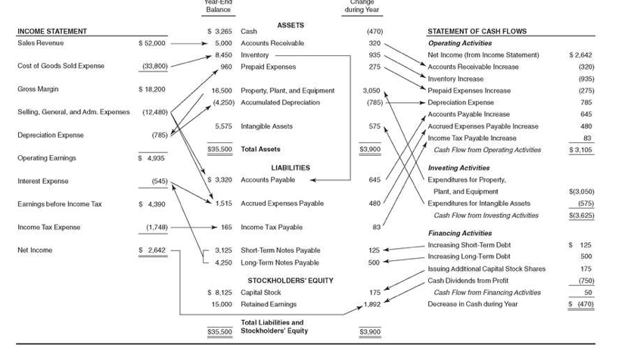

Slide 18
Capital Expenses
Need for expensive equipment, larger facility often signals need for new type of financing
Time horizons for debt match time horizons of use of proceeds

Slide 19
Funding cycle
Seed capital
Angel investors
Venture capital
  Early stage
  Late stage
Public offerings
Non dilutive funds
  Grants
  Business development
Product revenues and profit

Slide 20
Time horizons for positive cash flow generation
Service business
Franchises
Software
Light manufacturing
Heavy manufacturing
Exploration
R&D, regulation

Slide 21
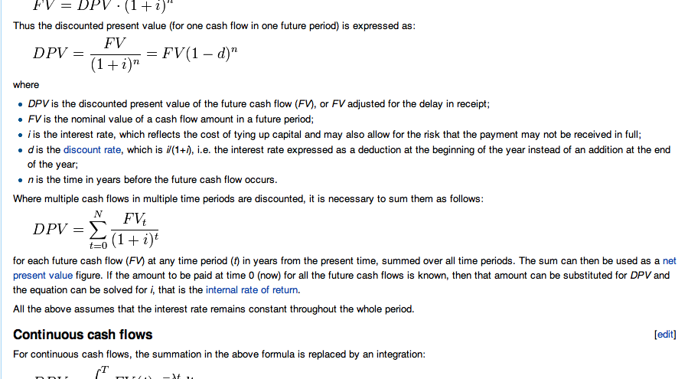
Discounted Cash Flow

