Slide 1
Entrepreneurship in Biotechnology
Columbia University
Graduate School of Arts and Sciences
BIOT 4180

Slide 2
Week 6
More Accounting and Finance

Slide 3
agenda
Homework
Review discounted cash flow
Financial statement diagnostics
Debt
Equity
Basic equity sales

Slide 4
agenda
Homework
Review discounted cash flow
Financial statement diagnostics
Debt
Equity
Basic equity sales

Slide 5
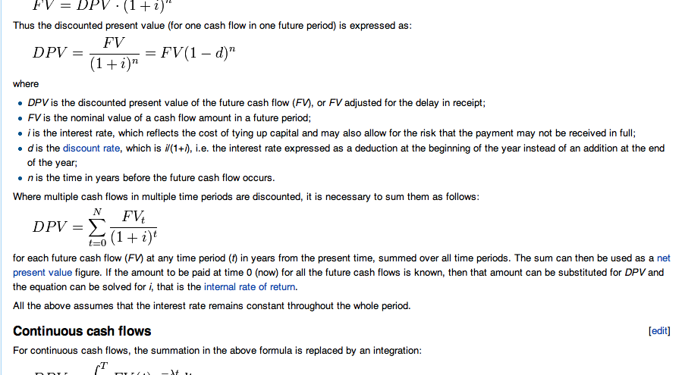
Discounted Cash Flow

Slide 6
agenda
Homework
Review discounted cash flow
Financial statement diagnostics
Debt
Equity
Basic equity sales

Slide 7
questions
Can the company pay its bills?
How profitable is the product(s)?
How much of the company would I own if I buy stock?
What are my options worth?
What is the cash burn?
Can the company raise money?

Slide 8
questions
Can the company pay its bills?
How profitable is the product(s)?
How much of the company would I own if I buy stock?
What are my options worth?
What is the cash burn?
Can the company raise money?
Balance sheet: working capital
Income statement: gross margin
Balance sheet: capital structure
Cash burn: cash flow statement
Cash flows (debt), cap structure (equity)

Slide 9
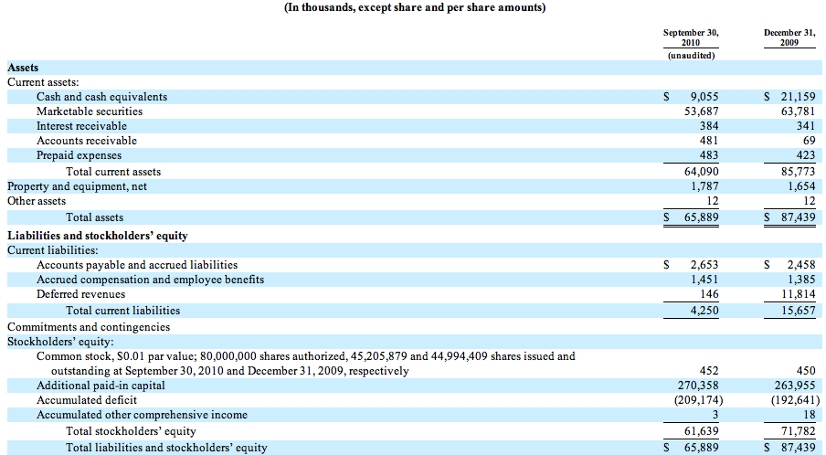
Balance sheet

Slide 10
questions
Can the company pay its bills?
How profitable is the product(s)?
How much of the company would I own if I buy stock?
What are my options worth?
What is the cash burn?
Can the company raise money?
Balance sheet: working capital
Income statement: gross margin
Balance sheet: capital structure
Cash burn: cash flow statement
Cash flows (debt), cap structure (equity)

Slide 11
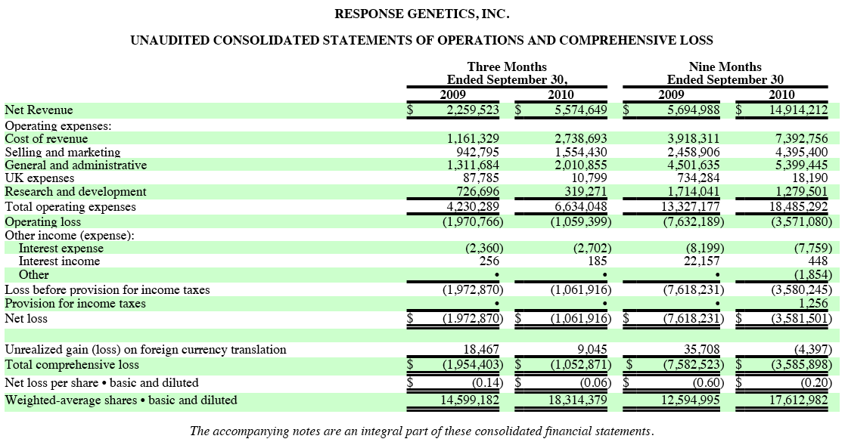
Income Statement with product sales

Slide 12
questions
Can the company pay its bills?
How profitable is the product(s)?
How much of the company would I own if I buy stock?
What are my options worth?
What is the cash burn?
Can the company raise money?
Balance sheet: working capital
Income statement: gross margin
Balance sheet: capital structure
Cash burn: cash flow statement
Cash flows (debt), cap structure (equity)

Slide 13
Simple Cap Structure

Slide 14
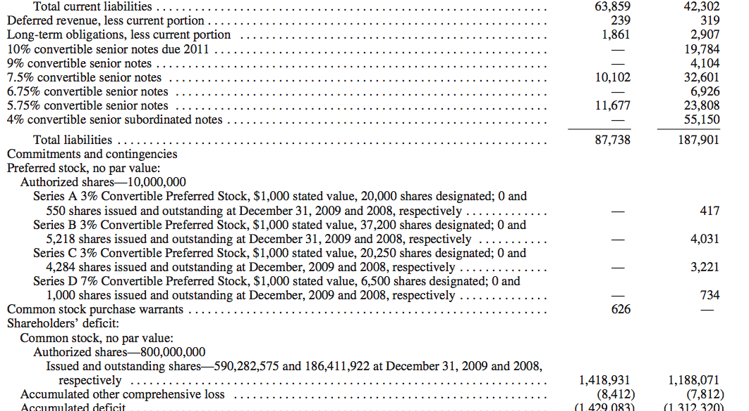
Complex cap structure

Slide 15
questions
Can the company pay its bills?
How profitable is the product(s)?
How much of the company would I own if I buy stock?
What is the cash burn?
Can the company raise money?
Balance sheet: working capital
Income statement: gross margin
Balance sheet: capital structure
Cash burn: cash flow statement
Cash flows (debt), cap structure (equity)

Slide 16
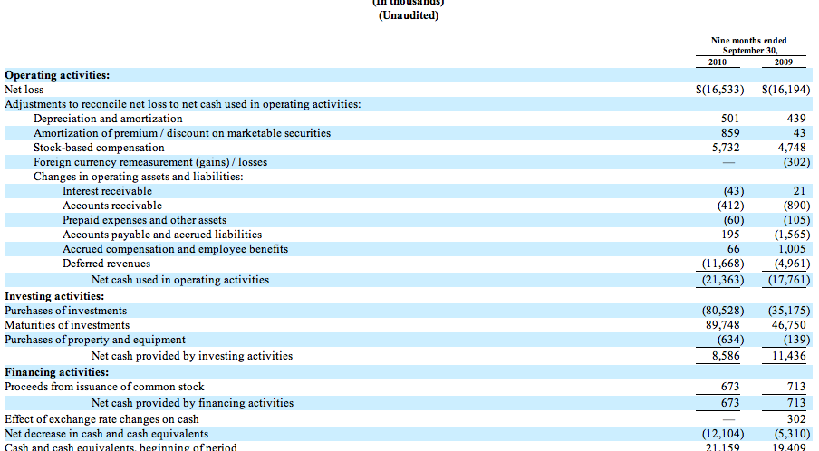
Cash Flow Statement

Slide 17
questions
Can the company pay its bills?
How profitable is the product(s)?
How much of the company would I own if I buy stock?
What is the cash burn?
Can the company raise money?
Balance sheet: working capital
Income statement: gross margin
Balance sheet: capital structure
Cash burn: cash flow statement
Cash flows (debt), cap structure (equity)

Slide 18
agenda
Homework
Review discounted cash flow
Financial statement diagnostics
Debt, equity and convertible debt
Basics of equity sales

Slide 19
agenda
Homework
Review discounted cash flow
Financial statement diagnostics
Debt
Equity
Basics of equity sales

