Slide 1
Week 9
Economics

Slide 2
Agenda
Where prices come from
Supply and demand curves
Market models
Perfect competition
Monopoly / monopsony
Oligopoly / oligopsony
Economic rent
Application to margins

Slide 3
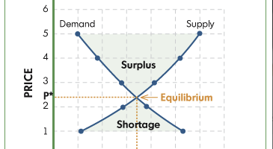
Pricing

Slide 4
Prices
Factors
Market demand
Different demands from different purchasers
Elasticity of demand
Market supply
Costs of inputs reflect relative scarcity of input
Pricing is a means of efficient allocation of resources
Interference with market pricing interferes with the efficient allocation of resources in a competitive market eg minimum wage or healthcare costs

Slide 5
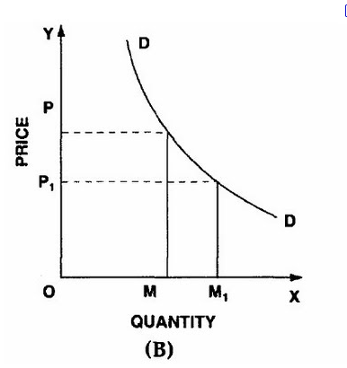
Demand curve
Downward sloping
Elasticity
Curve shifts in response to changes in taste, availability of competitive products
Be careful about narrow definition of competition!
Marketing attempts to shift the demand curve; news can shift demand curve

Slide 6
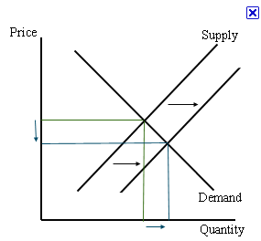
Supply curve
Upward sloping
Decrease in cost of inputs can shift supply curve
Can be elastic

Slide 7
Market Models
In perfect competition, neither suppliers nor consumers see the market curves
Monopolists see the market demand and have an incentive to decrease supply to maximize total revenue
Oligopolists try to create mini-industry demand curves by nonprice differentiation

Slide 8
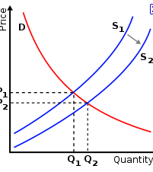
Subsidy (s1 to s2) and Licensure (s2 to s1)
Decreases the supply at all wage points
Results in lower availability at higher price
Question of consumer protection or guild protection?
Trade barriers, tarriffs

Slide 9
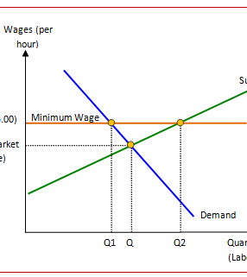
Minimum Wage
Greater supply of workers willing to work but
Less demand for labor at that price
Helps those who have jobs at that wage but
Harms those who would have worked for less

Slide 10
Pricing
In a competitive market, suppliers enter freely and bid down the price ~equal to the aggregate prices of inputs
In competitive market, each firm sees only the market price
In noncompetitive markets, firm sees the market demand curve
Limiting supply gives the supplier ability to set the price and maximize gross margin

Slide 11
Review
Keynes
Friedman
Fiscal policy
Monetary policy

